Slide 1

Sprocket Central Pty Ltd
Data analytics approach
Mevhare Afe

Slide 2
Agenda
Introduction
Data Exploration
Model Development
Interpretation

Slide 3
Introduction
Outline of the Problem
Sprocket Central Pty Ltd is a bikes & cycling accessories organization.
The marketing team is looking to boost business by analyzing provided datasets.
Using the existing 3 datasets, recommend which of these 1000 new customers should be targeted to drive the most value for the organization.
Contents
Data Quality Assessment
Profit by Product line
Number of Cars owned by state
Wealth Segment by Age group
RFM Analysis using K-Means Clustering and Customer Segmentation
Appendix

Slide 4
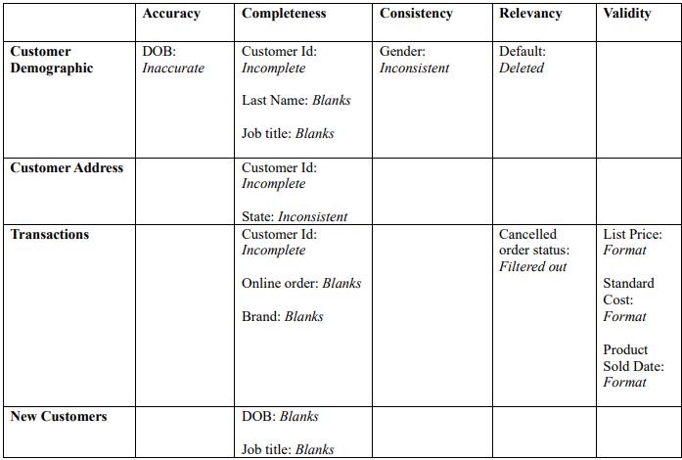
Data Exploration
Data Quality Assessment
This is a summary of key issues and cleaning on the data provided.
Check the appendix for the detailed e-mail

Slide 5
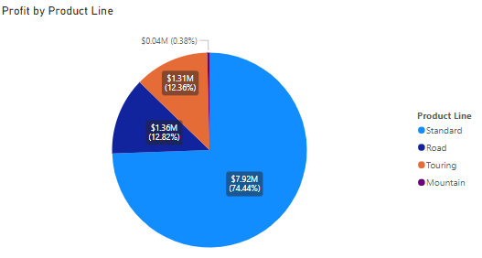
Data Exploration
Profit By Product Line
Standard products are the most profitable
Road and Touring products generate similar amounts of profit.
Mountain is the least profitable product line.

Slide 6
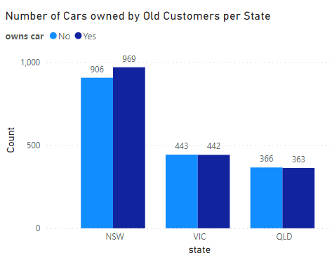
Data Exploration
Number of Cars Owned
Most of our customers reside in NSW.
NSW has the most customers that do and do not own cars.
VIC and QLD are basically evenly shared for the number of car and non-car owners.

Slide 7
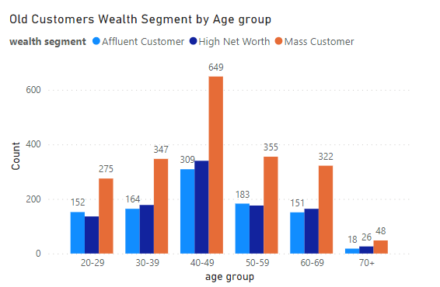
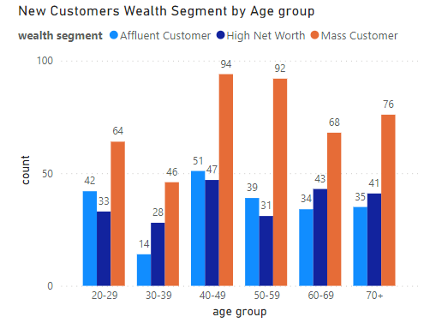
Data Exploration
Wealth Segment by Age group
Most customers are aged between 40-49 between old and new customers.
A significant increase In customers that are 70+ in the new customer list.
High Net Worth Customers are mostly within the 40-49 age group.
Mass Customers dominate across all age groups for both old and new customers.

Slide 8
Model Development
RFM Analysis using K-Means Clustering
K-means clustering algorithm using RFM (Recency, Frequency and Monetary) features to segment Sprocket's customers based on their purchasing patterns, preferences, and interactions with the company.
By utilizing this data-driven approach, Sprocket can develop more effective marketing strategies, enhance customer satisfaction, and drive business growth.
Check the appendix for detailed analysis

Slide 9
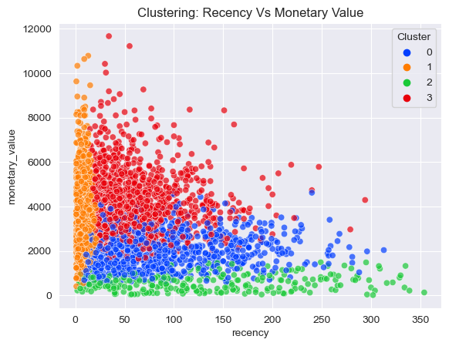
Model Development
Recency vs Monetary Value
Customers that purchased recently generate the most profit.
Negative relationship between recent purchases and monetary value.

Slide 10
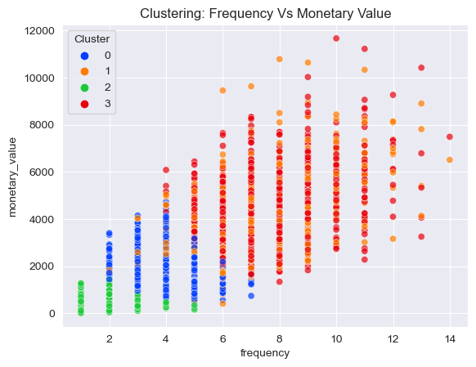
Model Development
Frequency vs Monetary Value
Customers that purchase frequently generate the most profit.
There is a positive relationship between frequency and monetary value.
Clusters 1 and 3 are the most likely to generate the most profit for the store.

Slide 11
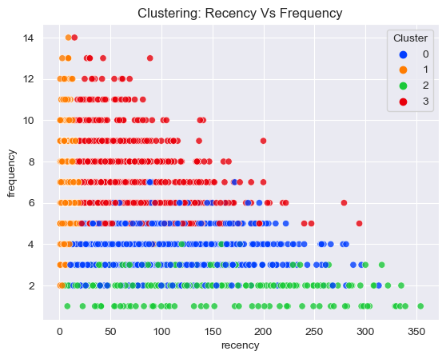
Model Development
Frequency vs Recency
Customers that purchase recently are also your most frequent customers.
There is a negative relationship between frequency and frequency.
Clusters 1 and 3 are the most likely to purchase more items from the store.

Slide 12
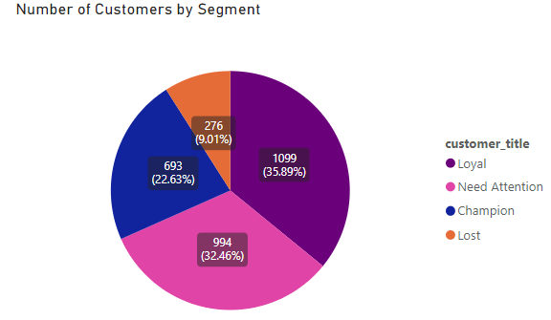
Interpretation
Customer Title Definition
Cluster | Customer Title | Description | Count
0 | Need Attention | They are considered low-spenders with a low number of orders. | 994
1 | Champion | They are the most frequent buyers who spend a significant amount on your products. | 693
2 | Lost | Customers who were once active but have become disengaged. | 276
3 | Loyal | Customers that are responsive to promotions. They purchase the most frequently. | 1099

Slide 13
Interpretation
Customer Target
Filter through the new customer list to select customers who meet these conditions.
These are customers that tend to purchase recently, and frequently and also tend to spend the most.
Customer Title | Description
Champion | They are the most frequent buyers who spend a significant amount on your products.
Loyal | Customers that are responsive to promotions. They purchase the most frequently

Slide 14
Appendix

Slide 15
Appendix
Data Assessment E-Mail
Customer Segmentation using K-Means Clustering

